Slide 1
Workbook Target Operating Model
Internal Use Only
April 2017

Slide 2
Disclaimer
The content of this workbook has been produced by KPMG Germany/Deal Advisory on the basis of German accounting standards and/or IFRS, as well as considering KPMG Germany’s firm and country requirements, regulations, processes, policies and best practices. Please check your local accounting and other requirements before applying the content.

Slide 3
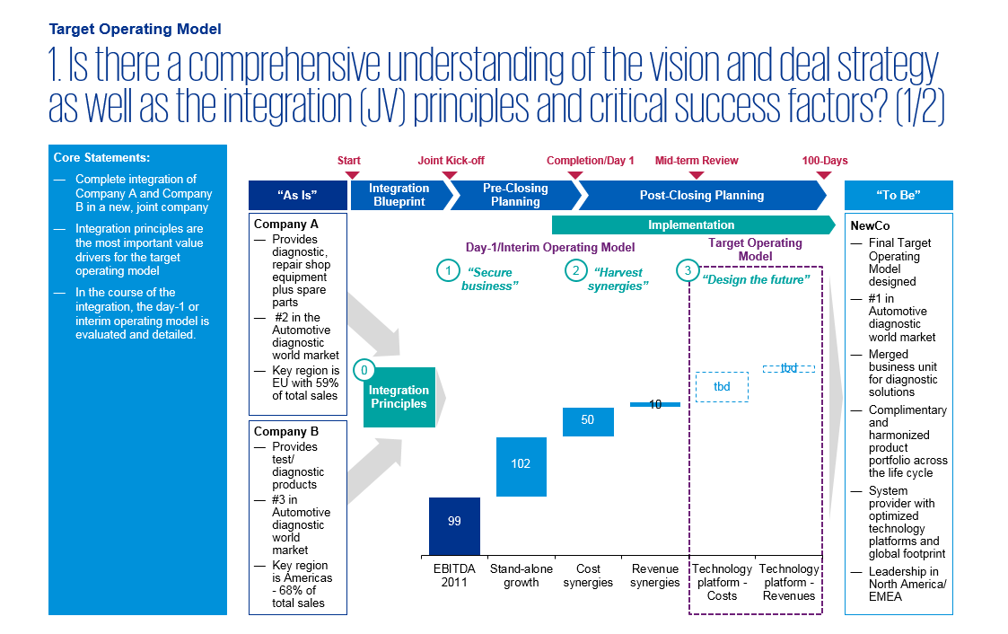
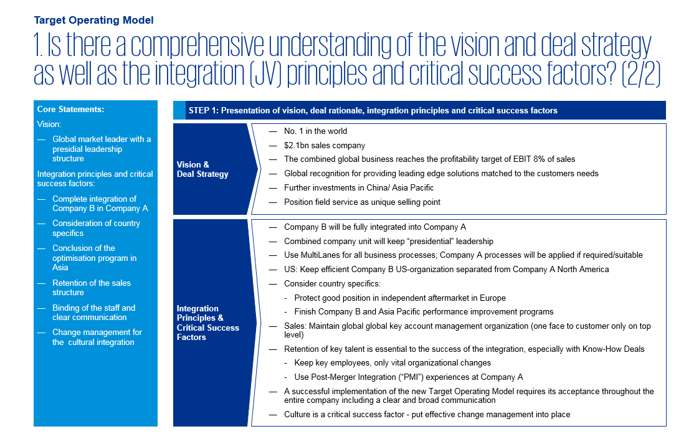
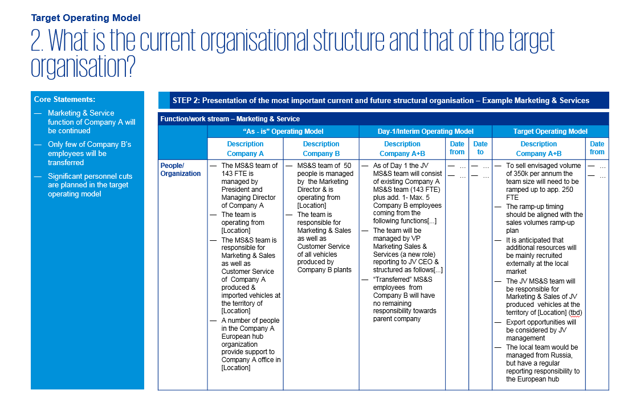
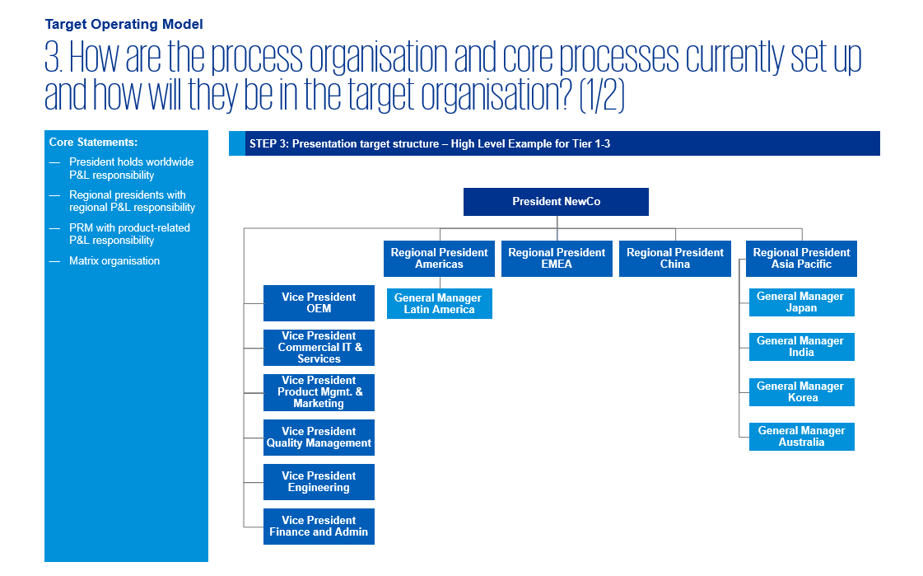
Overview (1/6) – Mission statement
Target Operating Model
Mission Statement:
The target operating model (TOM) provides a clear overview of the elementary changes in the course of the transformation related to the structural and process organization as well as the assets and contract.
Customer situation
Definition/Methodology/Tools of the basis analysis
Buy Side/JV
The target operating model is based on the blueprint
The TOM design process on the buy side is primarily driven by the buyer
With a JV the design process is basically the same, the approval process is, however, more extensive due to the issues of governance as well as revenue/cost-sharing
Definition
The target operating model represents a clearly defined target structure in which the relevant unit should operate in future.
It consists of the structural and process organization as well as the assets needed and the contractual regulations required – internal and external.
Methodology
The TOM is based on a detailed "as is" presentation of the current situation, for both the buyer as well as the seller or from the sides of the JV partners.
Based on this, a "target" structure that is approved by all relevant stakeholders and a presentation of the transitional solution (interim structure) is developed
The structuring is performed according to the areas along the value chain and the administrative functions down to the region/countries. In its basic form five elementary dimensions are examined:
Personnel/Organization: How is the organization structure set up?
Processes: How are the process organization and the interfaces organized?
IT/ IS/ technology: Which technologies/systems are required? How is the access assured?
IP/Contracts: What rights and contracts are required? How should these be designed?
Assets: Which ones are required? How can the access/use be assured?
Tools and templates
PowerPoint output
Degree of standardization
The method for determining the TOM (structured interviews, workshops) as well as the final output (PowerPoint incl. tables, organizational chart) are for the most part standardized
Content is adapted to the specific customer

Slide 4
Overview (2/6) – Pitfalls
Target Operating Model
No. | Pitfalls/Lessons learned
 | Lack of a clear and coherent vision and deal rationale with regard to the future business model hinder the success of a TOM and the target value generation. An integration or JV blueprint that clearly and understandably presents the integration or JV principles derived from the vision and the deal rationale is an absolutely essential starting point for a value-generating target operating model.
 | The inclusion of the target and various workstreams in the development process of the TOM has proven to be very helpful. In this way, erroneous outside-in assumptions on the business model, organizational structure and process can be avoided. In addition, it increases the level of acceptance of the blueprints with the target. A sufficient amount of time should be planned for the joint as-is understanding.
 | An interim operating model developed during the pre-closing phase can deviate significantly from a target operating model that is finally approved in the end. The reasons for this are the limited access to information on the buyer’s side and the implementation duration. After the closing, the assumptions based on the interim operating model must be reviewed. In addition, the target operating model gets more detailed during the transaction process.
 | "Merger of equals“ or a "best-of-both-worlds“ integration approach or a joint venture of equal partners present special challenges for the TOM approval and development process. Clear communication and decision-making rules, focus on the internal and external best practices and the quantification of financial influences promote an efficient and effective TOM development process.
 | Corporate cultures and behavioral expectations have a decisive impact on the success of a TOM. The TOM should therefore also consider the specific corporate culture and possible behavioral patterns of the relevant stakeholders. Cultural assessments and an active change management accompaniment prior to and during the implementation have a positive impact on the success of a TOM.
 | Change requirements of the TOM are often considered to be threatening by internal and external stakeholders or fail in the implementation of the daily business. Managing possible reactions and resistance is decisive for the success of a TOM. With the aid of stakeholder mapping and specific communication and implementation measures, it is possible to analyze the varying expectations, identify potential risks and obtain the necessary buy-in (see also workbook People, Culture and Communication).
1
2
3
4
5
6

Slide 5
Overview (3/6) – Core issues
Target Operating Model
Core Issue | Specific analysis | Page(s)
Is there a comprehensive understanding of the vision and deal strategy/rationale as well as the integration (JV) principles and their critical success factors? | Analysis/Review of the integration (JV) blueprints incl. vision, and deal rationale and integration (JV) principles Determination of the critical success factors and resources needed | 9-10
2. What is the current organizational structure and that of the target organization? | Overview of the legal structure (no. of companies, shares in affiliated companies, etc.) Overview of the operating structures (geographic vs. functional focus of the companies/areas, internal approval between companies/areas, centralization/decentralization, shared services, P&L responsibilities, etc.) Writing of job profiles, management appraisal and nomination Presentation of the staff structure and FTE allocations per company/area/function, possible personnel reduction or hiring measures | 11
How are the process organization and core processes currently set up and how will they be in the target organization? | Presentation of the governance rules, core processes and the most important decision-making processes Definition of scalable "best-in-class“ core processes and future service levels Presentation of needed resources and relevant interfaces for assuring smooth processes Presentation of possible process risks | 12-13
What technologies/systems are currently used and will be required in the future? | Overview of the technologies/systems used and the corresponding ownership Presentation of the required technologies/systems and adaptations Presentation of access alternatives | 14
What important property rights and contracts do currently exist and will be required in future? | Presentation of the most important contracts for the operating business (contract parties, services, change-of-control clauses, etc.) and adjustments required Presentation of the most important property rights, licenses and rights of use for external or affiliated companies and required adjustments Presentation of the impact of the adjustments on the cost structure | 15
What assets do currently exist and will be required in future? | Presentation of the assets and their ownership, which are relevant to the operational business Presentation of access and usage possibilities | 16

Slide 6
Overview (4/6) – Placement in the overall integration process
Target Operating Model
4 weeks
10-12 weeks^{(a)}
100 days
100 days +
Pre-Signing
Pre-Closing
Post-Closing first 100-Days
Beyond the ...deal
Beyond the ...deal
Signing
Completion/Day 1
100 Days
Objective:
Confirm and document the strategic intent, value drivers, initial view on the target operating model and high level target structure Documentation and approval:
Deal rationale
Depth of integration
Risks and measures
High level target structure (organization)
High level synergy assessment
Stakeholder mapping and approved communication elements
Timeline for the integration
Objective:
Guarantee “day-1 readiness“ for control over the process, the integration goals and the daily business as of closing; target operating model and synergy case
Documentation and approval:
“Take control“ as of day of closing
As-is, interim and target operating model
Change management, culture and retention plan
Synergy case
Communication plan
Objective:
Minimize disruption to business as usual, deliver Quick Wins and integrate fast and effectively
Implementation:
Realized quick wins
Adjusted financial business plan (bottom-up)
Robust benefit & synergy tracking including corresponding project structure
Initial validation / detailing TOM
Objective:
Successfully complete Integration and identify further areas for operational improvement
Realized synergies / value from the deal
Completed required integration projects
Identification of value levers and implementation of on-going optimization measures
Captured learnings from integration for further deals within the internal team
Perform “second wave of integration“ if necessary
Vision and
approach
Value
Control
People and culture
PMO
Objective
Establish and maintain appropriate processes and integration governance (adequately resourced) to ensure that the Integration Program stays on track and deal objectives are delivered
Note: (a) The time between signing and closing may be between 0 (same day) and several months

Slide 7
Overview (5/6) – Approach with unlimited access to information prior to closing
Target Operating Model
Details on Methodology/Approach
1
2
3
Understanding initial basis
Develop operating model
Coordination & approval
Further integration/JV approach
Understanding initial basis
Develop interim and target operating model (pre-closing)
Coordination and approval
1
2
3
Approach:
Develop understanding of the blueprint, i.e. vision, the deal rationale and integration (JV) principles
Performance of workshops for each function and cross-functional workshops for mutual presentation and discussion of the as-is operating models with participation of buyers and target or JV partners
Determine the critical success factors and necessary resources
Approach:
Development of a high level interim and target operating model (e.g. tier 1-3) by buyer‘s management or the two JV partners (if not already covered in the blueprint) in a small group
Development of a detailed interim and target operating model for each workstream/ function by the nominated project members (participation of buyer and target or both JV partners)
Summary of results and, if needed, further coordination in an alignment workshop with all workstreams
Approach:
Approval of the operating models for each workstream/function by the workstream sponsors
Approval by the PMO
Approval by the top management/steering committee
Presentation to the project staff in the kick-off meeting after the signing or closing
Process steps

Slide 8
Overview (6/6) – Approach with limited access to information prior to closing
Target Operating Model
Details on Methodology/Approach
1
2
3
4
Understanding initial basis
Develop day-1/IOM
Develop TOM
Coordination & approval
Further integration/JV approach
Understanding initial basis
Develop interim operating model (pre-closing)
Develop target operating model (post-closing)
Coordinate & approve (pre- and post-closing)
1
2
3
4
Approach:
Develop an understanding of the blueprint, i.e. vision, the deal rationale and integration (JV) principles
Independent development of the as-is operating models per workstream/function by buyer, target or JV partner
Generate outside-in understanding for the as-is models of the target or JV partner
Determine the critical success factors and resources required
Approach:
Development of a high level interim and target operating model (e.g. tier 1-3) by buyer’s management or the two JV partners
Form hypotheses on the target operating model for each workstream/function
Development of an interim operating model for each workstream by nominated workstream members of the buyer
Summary of results
Approach:
Performance of workshops for each function and cross-functional workshops for the mutual presentation and discussion of the as-is operating models with participation of the buyer and target or JV partners
Evaluation of the hypotheses of TOM
Detailing the TOM for each workstream by the individual workstream measures
Approach:
Release of the operating models by each workstream/ function by the workstream sponsors (pre and post closing)
Approval by the PMO
Approval by top management/ steering committee
Presentation of the interim operating models to the project members and defined group of employees at closing
Presentation of TOM to the project staff after closing
Process steps

Slide 9
1. Is there a comprehensive understanding of the vision and deal strategy as well as the integration (JV) principles and critical success factors? (1/2)
Target Operating Model
Core Statements:
Complete integration of Company A and Company B in a new, joint company
Integration principles are the most important value drivers for the target operating model
In the course of the integration, the day-1 or interim operating model is evaluated and detailed.
Start
Joint Kick-off
Completion/Day 1
Mid-term Review
100-Days
“As Is”
Integration Blueprint
Pre-Closing Planning
Post-Closing Planning
“To Be”
Company A
Provides diagnostic, repair shop equipment plus spare parts
#2 in the Automotive diagnostic world market
Key region is EU with 59% of total sales
Implementation
NewCo
Final Target Operating Model designed
#1 in Automotive diagnostic world market
Merged business unit for diagnostic solutions
Complimentary and harmonized product portfolio across the life cycle
System provider with optimized technology platforms and global footprint
Leadership in North America/ EMEA
Day-1/Interim Operating Model
Target Operating Model
1
2
3
“Secure
business”
“Harvest
synergies”
“Design the future”
0
Integration Principles
Company B
Provides test/ diagnostic products
#3 in Automotive diagnostic world market
Key region is Americas - 68% of total sales

Slide 10
1. Is there a comprehensive understanding of the vision and deal strategy as well as the integration (JV) principles and critical success factors? (2/2)
Target Operating Model
Core Statements:
Vision:
Global market leader with a presidial leadership structure
Integration principles and critical success factors:
Complete integration of Company B in Company A
Consideration of country specifics
Conclusion of the optimization program in Asia
Retention of the sales structure
Binding of the staff and clear communication
Change management for the cultural integration
Step 1: Presentation of vision, deal rationale, integration principles and critical success factors
Vision & Deal Strategy
No. 1 in the world
$2.1bn sales company
The combined global business reaches the profitability target of EBIT 8% of sales
Global recognition for providing leading edge solutions matched to the customers needs
Further investments in China/ Asia Pacific
Position field service as unique selling point
Integration Principles & Critical Success Factors
Company B will be fully integrated into Company A
Combined company unit will keep “presidential” leadership
Use MultiLanes for all business processes; Company A processes will be applied if required/suitable
US: Keep efficient Company B US-organization separated from Company A North America
Consider country specifics:
Protect good position in independent aftermarket in Europe
Finish Company B and Asia Pacific performance improvement programs
Sales: Maintain global key account management organization (one face to customer only on top level)
Retention of key talent is essential to the success of the integration, especially with Know-How Deals
Keep key employees, only vital organizational changes
Use Post-Merger Integration (“PMI”) experiences at Company A
A successful implementation of the new Target Operating Model requires its acceptance throughout the entire company including a clear and broad communication
Culture is a critical success factor - put effective change management into place

Slide 11
2. What is the current organizational structure and that of the target organization?
Target Operating Model
Core Statements:
Marketing & Service function of Company A will be continued
Only few of Company B’s employees will be transferred
Significant personnel cuts are planned in the target operating model
Step 2: Presentation of the most important current and future structural organization – Example Marketing & Services
Function/work stream – Marketing & Service
 | “As - is” Operating Model |  | Day-1/Interim Operating Model |  |  | Target Operating Model
 | Description Company A | Description Company B | Description Company A+B | Date from | Date to | Description Company A+B | Date from
People/ Organization | The MS&S team of 143 FTE is managed by President and Managing Director of Company A The team is operating from [Location] The MS&S team is responsible for Marketing & Sales as well as Customer Service of Company A produced & imported vehicles at the territory of [Location] A number of people in the Company A European hub organization provide support to Company A office in [Location] | MS&S team of 50 people is managed by the Marketing Director & is operating from [Location] The team is responsible for Marketing & Sales as well as Customer Service of all vehicles produced by Company B plants | As of Day 1 the JV MS&S team will consist of existing Company A MS&S team (143 FTE) plus add. 1 - max. 5 Company B employees coming from the following functions[...] The team will be managed by VP Marketing Sales & Services (a new role) reporting to JV CEO & structured as follows[...] “Transferred” MS&S employees from Company B will have no remaining responsibility towards parent company | … … | … … | To sell envisaged volume of 350k per annum the team size will need to be ramped up to app. 250 FTE The ramp-up timing should be aligned with the sales volumes ramp-up plan It is anticipated that additional resources will be mainly recruited externally at the local market The JV MS&S team will be responsible for Marketing & Sales of JV produced vehicles at the territory of [Location] (tbd) Export opportunities will be considered by JV management The local team would be managed from [Location], but have a regular reporting responsibility to the European hub | … …

Slide 12
3. How are the process organization and core processes currently set up and how will they be in the target organization? (1/2)
Target Operating Model
Core Statements:
President holds worldwide P&L responsibility
Regional presidents with regional P&L responsibility
PRM with product-related P&L responsibility
Matrix organization
Step 3: Presentation target structure – High Level Example for Tier 1-3
President NewCo
Regional President Americas
Regional President EMEA
Regional President China
Regional President Asia Pacific
General Manager
[Location 1]
General Manager
[Location 2]
Vice President
OEM
General Manager
[Location 3]
Vice President
Commercial IT & Services
General Manager
[Location 4]
Vice President
Product Mgmt. & Marketing
General Manager
[Location 5]
Vice President
Quality Management
Vice President
Engineering
Vice President
Finance and Admin

Slide 13
3. How are the process organization and core processes currently set up and how will they be in the target organization? (2/2)
Target Operating Model
Core Statements:
Steering according to products in Company A
Steering according to regions in Company B
Future steering according to products regions and customers
Takeover of the value-based management of Company A
Takeover of the monthly forecasts of Company B
Step 4: Presentation of the most important current and future core processes - Example Controlling
Function/work stream – Finance – Controlling
 | “As - is” Operating Model |  | Interim Operating Model |  |  | Target Operating Model
 | Description Company A | Description Company B | Description Company A+B | Date from | Date to | Description Company A+B | Date from
Process (how?) | Steering concept is orientated to product areas and products 1 Annual plan, four forecasts (in annual buckets) Focus on planning data (basis for incentive measurement) Project review process exists based on defined guideline Focused on sales and profit Uses resale and cost plus transfer pricing methods | Steering concept is orientated to regions 1 Annual plan, 12 outlooks (in monthly buckets) Focus on outlook data (basis for incentive measurement) Weekly leadership team project review for projects bigger than 100 TUSD Company B is focused on cash flows in addition to sales and profit | Enable Company B steering on product or customer level Maintain status quo for the annual plan and forecast method Continue with focus on both data approaches Continue weekly leadership team project review for projects bigger than 100 TUSD Focuses on sales and profit and uses Company A value based management concept Start with status quo regarding transfer pricing Cross selling between Company A and B must be possible | … … | … … | Steering on products, customers and regions Implement 12 months outlook process Alignment between focus (i.e. on planning data) and incentive Continue weekly leadership team project review for projects bigger than 100 TUSD in compliance with the guidelines of Company A Focus on sales and profit and use of Company A’s values based management concept Compliant transfer pricing methods implemented Product sales independent from locations | … …

Slide 14
4. What technologies/systems are currently used and will be required in future?
Target Operating Model
Core Statements:
Creation of interfaces between the different systems as needed
Variety of the CAM systems is significantly reduced
Step 5: Presentation of the most important current and future technologies and systems - Example Manufacturing
Function/work stream – Manufacturing
 | “As - is” Operating Model |  | Interim Operating Model |  |  | Target Operating Model
 | Description Company A | Description Company B | Description Company A+B | Date from | Date to | Description Company A+B | Date from
IT (HW) & IS (SW) | UG - NX UG - NX CAM module Team center (Engineering / CAM department) Vericut Delcam Powermill Zeiss Calypso Baan OFS (Time Management) SharePoint Business Objects MS Office (Measuring Reports) | CAD: - ProE Elite (viewer) CAM: - Tebis Alphacam Powermill (Delcam) Powershape PEPS Korvik 3D-Program (DMG) ERP Workplan EAM Lotus Notes CAQ Babtec ZS Plan Zwicker MES ZS Framework Zwicker ZEISS measuring software Calypso EROWA presetting station (“Q-Messen”) | See Target Operating Model | … … | … … | If required and needed, system interfaces will be established, to ensure data transfer between the different systems. The variety of currently utilized CAM systems at KTW will be significantly reduced with the introduction of Hypermill for the programming of milling machines. TeamCenter will be introduced to be the standard CAD/CAM data management system. Individual requirements still will be supported through adapted system solutions. | … …

Slide 15
5. What important property rights and contracts currently exist and will be required in future?
Target Operating Model
Core Statements:
Currently 1,000 and more contracts on both sides
Analysis of the contract overlaps and renewal of critical contracts in the interim operating model
New general terms and conditions negotiated in the target operating model
Step 6: Presentation of the most important current and future property rights and contracts – Example Procurement
Function/work stream – Purchasing
 | “As - is” Operating Model |  | Interim Operating Model |  |  | Target Operating Model
 | Description Company A | Description Company B | Description Company A+B | Date from | Date to | Description Company A+B | Date from
IP/Contracts | Company A is currently maintaining ca. 1500 non-production & 40 production contracts which are under supervision of the Purchasing function | Company B is currently maintaining ca. 1000 non-production & 100 production contracts which are under the supervision of the Purchasing function | Contracts overlaps are identified and the approach to deal with them is defined Critical contracts are novated to (fill in legal entity) to support JV operations Phased approach for amendment of non-critical contracts is defined Supply terms in key contracts are renegotiated where appropriate Appropriate communication with key affected suppliers is completed | … … | … … | Contracts base is aligned and best-practice approach is applied All purchasing contracts are novated to new legal entity and where applicable new T&C’s are renegotiated | … …

Slide 16
6. What assets currently exist and will be required in the future?
Target Operating Model
Core Statements:
Both companies maintain warehouses in various locations worldwide
Consolidation of the warehouses is not planned at the moment
Step 7: Presentation of the most important current and future assets - Example Logistics
Function/work stream – Finance – Controlling
 | “As - is” Operating Model |  | Interim Operating Model |  |  | Target Operating Model
 | Description Company A | Description Company B | Description Company A+B | Date from | Date to | Description Company A+B | Date from
Facilities/ Assets | Leased warehouses: Location A: central warehouse in Europe Location B: warehouse for spare parts only Location C: warehouse for special tools only Location D: central warehouse in North America Location E Owned warehouses: Location F: central warehouse for worldwide logistics Location G: warehouse for special tools only | Leased warehouses: Location H: central warehouse for North America Location I: central warehouse for Asia pacific Location J: central warehouse for Europe | No changes compared to as-is besides, Relocations of Company B Location K location to Location L plant | … … | … … | Consolidation of existing locations/ warehouses to be defined based on value stream simulations and discussions with target company | … …

Slide 17
© 2017 KPMG International Cooperative (“KPMG International”). KPMG International provides no client services and is a Swiss entity with which the independent member firms of the KPMG network are affiliated.

